Slide 1





TO TREAT OR NOT TO TREAT
THAT IS THE QUESTION
Ruth Kandel, MD
Director, Infection Control
Hebrew SeniorLife
Assistant Professor
Harvard Medical School
Boston, MA
Consultant to Massachusetts Partnership Collaborative:
Improving Antibiotic Stewardship for UTI

Slide 2
Objectives
Define whether to screen for or treat asymptomatic bacteriuria in an elderly population
Review complications of antibiotic use
Define symptomatic urinary tract infections
Review challenges of diagnosis in the elderly

Slide 3
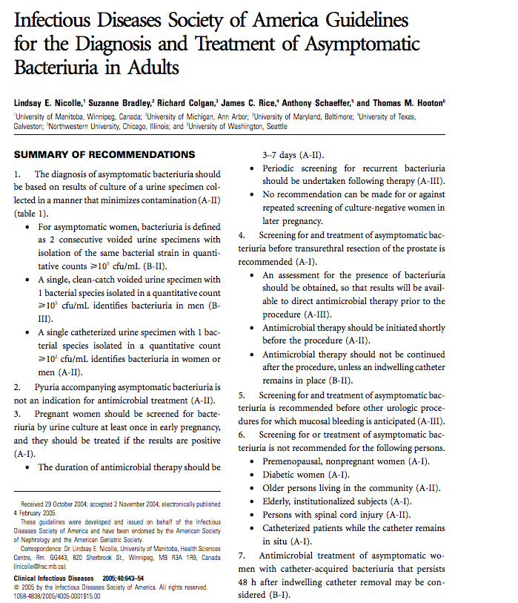
Clinical Infectious Disease 2005;40:643-654

Slide 4
What is Asymptomatic Bacteriuria?

Slide 5
Asymptomatic Bacteriuria (ASB)
Laboratory diagnosis
Positive urine culture
  Colony count significant (> 10⁵ cfu/mL)
Absence of symptoms
                Clinical Infectious Disease 2010;50:625-663

Slide 6
Pyuria
  Pyuria (> 10 WBC / high-power field) is evidence of inflammation in the genitourinary tract
    In persons with neutropenia significant bacteriuria may occur without pyuria
  Pyuria is commonly found with ASB
    Elderly institutionalized residents 90% (Infect Dis Clin North Am 1997;11:647-62)
    Short-term (< 30 days) catheters 30-75% (Arch IM 2000;160:673-82)
    Long-term catheters 50-100% (Am J Infect Control 1985;13:154-60)

Slide 7
Treatment for ASB Indicated
Pregnant women
  Increased risk for adverse outcomes
Urologic interventions
    TURP
    Any urologic procedure with potential mucosal bleeding

Slide 8
Treatment for ASB Not Indicated
Premenopausal, non pregnant women
Diabetic women
Older persons living in the community
Elderly living in long term care facilities
Persons with spinal cord injury
Catheterized patients
                CID2005;40:643-654

Slide 9
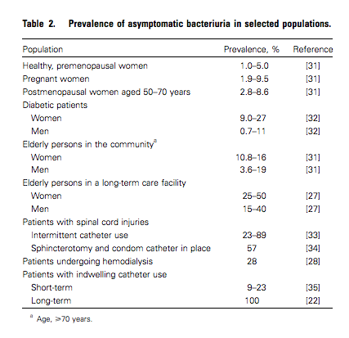
Clinical Infectious Diseases2005;40:643–54

Slide 10
No Benefit Treating ASB in the Elderly
Large long-term studies of ASB in pre and postmenopausal women
  NO ADVERSE OUTCOMES if not treated
Randomized studies (treatment vs. no treatment) in elderly LTC residents
  NO BENEFIT to treatment
  No decreased rate of symptoms
  No improved survival
                CID2005;40:643-654

Slide 11
Prospective Randomized Studies
Treatment vs. No Treatment ASB
Authors | Subjects | Intervention | Outcome
Nicolle LE, et al. NEJM 1983;309:1420-5 | Men, NH, median age 80 | Treated 16 Not treated 20 Duration 2 years | No difference mortality or infectious morbidity 2 groups
Nicolle LE, et al. Am J Med 1987;83:27-33 | Women, NH, median age 83 | Treated 26 Not treated 24 Duration 1 year | No difference mortality/GU morbidity. Increase drug reactions and AB resistance treated group.
Abrutyn E, et al. Ann Intern Med 1994;120:827-33 | Women, ambulatory and NH Mean age 82 | Treated 192 Not treated 166 Duration 8 years | No survival benefit from treatment
Ouslander JG Ann Intern Med 1995;122:749-54 | Women and men NH Mean age 85 | Treated 33 Not treated 38 Duration 4 weeks | No difference chronic urinary incontinence

Slide 12
Cohort Studies
Authors | Subjects | Observation | Outcome
JAGS 1990;38:1209-14 | Men, Ambulatory, > 65 years | 29 Subjects Duration 1-4.5 years | No adverse outcomes attributed to no treatment
NEJM 1986;314:1152-6 | Population based Swedish men and women | Duration 5 years | No association between bacteriuria and survival
Gerontology 1986;32:167-71 | Population based Finnish men and women > 85 years | Duration 5 years | No association between bacteriuria and survival

Slide 13
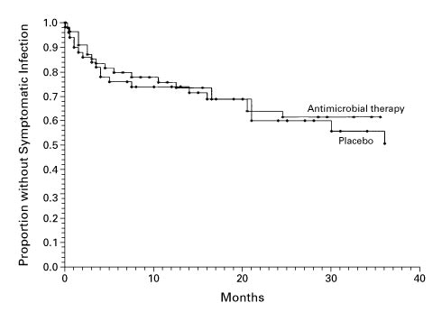

Proportion of Women with Diabetes Who Remained Free of Symptomatic Urinary Tract Infection, According to Whether They Received Antimicrobial Therapy or Placebo at Enrollment.
Harding GK et al. N Engl J Med 2002;347:1576-1583.
Notes:
Figure 1. Proportion of Women with Diabetes Who Remained Free of Symptomatic Urinary Tract Infection, According to Whether They Received Antimicrobial Therapy or Placebo at Enrollment. There was no significant difference between groups in the time to the first symptomatic urinary tract infection (P=0.67 by the log-rank test).

Slide 14
IDSA Recommendations
Routine screening for and treatment of ASB in older individuals in the community is not recommended.
Screening for and treatment of ASB in elderly residents in LTCFs is not recommended.
                CID2005;40:643-654

Slide 15

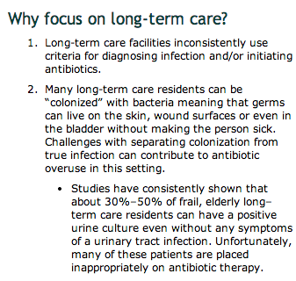

Slide 16
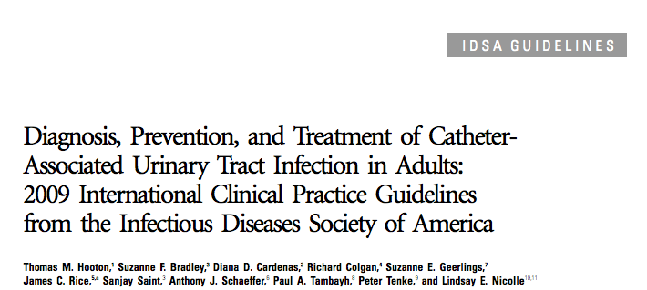
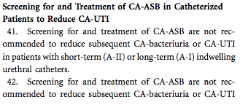
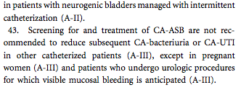

Slide 17
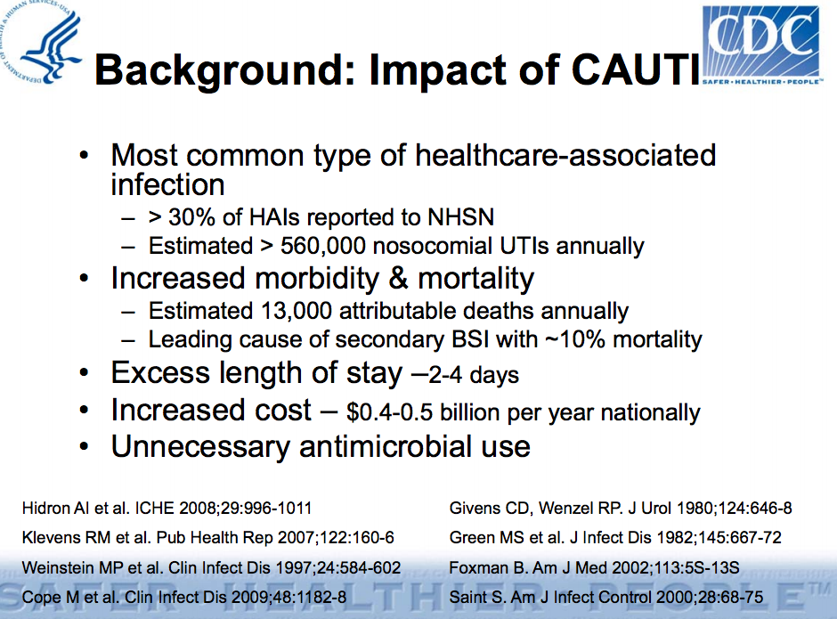

Slide 18
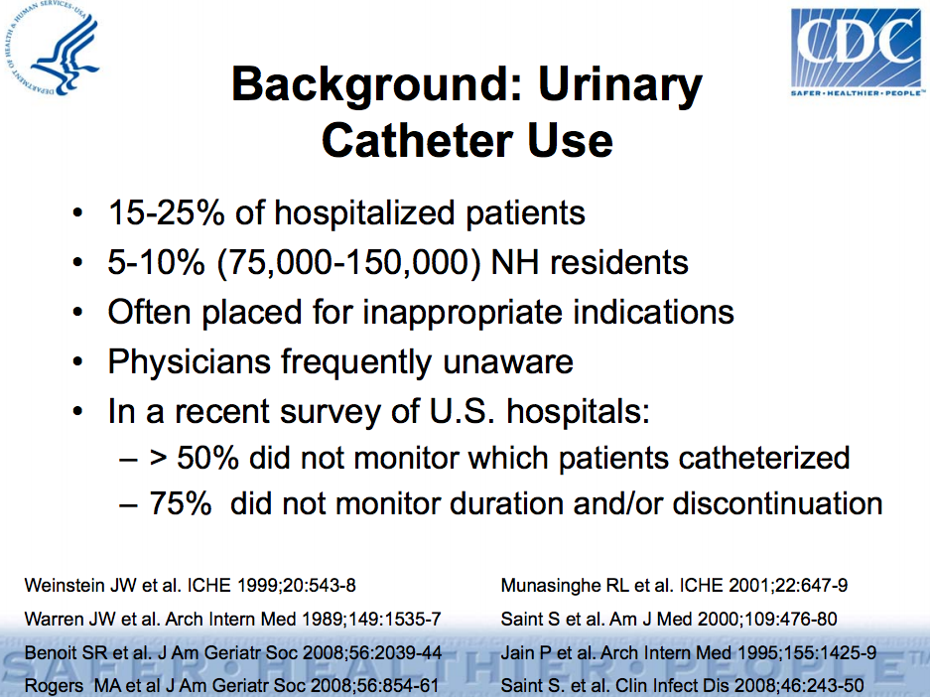

Slide 19

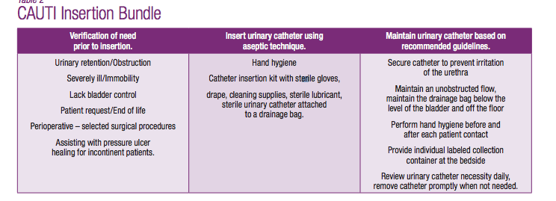

Slide 20
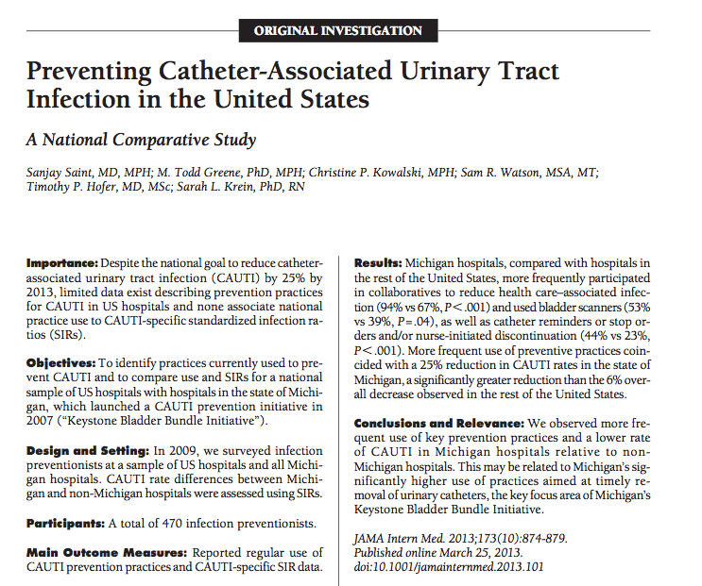

Slide 21
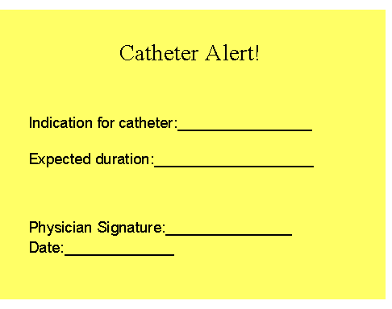

Slide 22

Any Problems Just Treating?

Slide 23
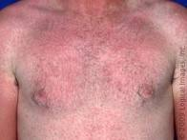
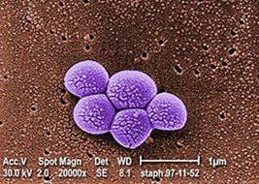
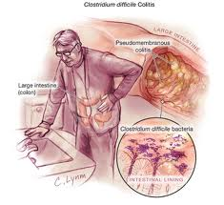
Problems with Antibiotics
Adverse Drug Reactions
MDRO
C Difficile Infection

Slide 24
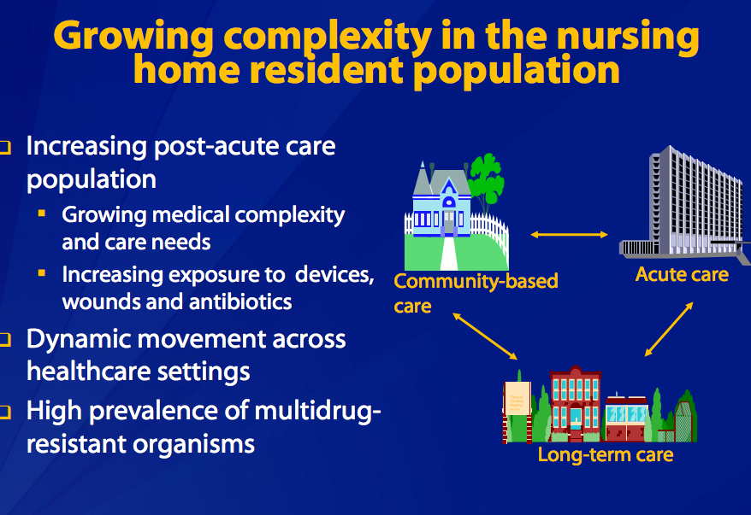

Slide 25

Clostridium Difficile Infection

Slide 26
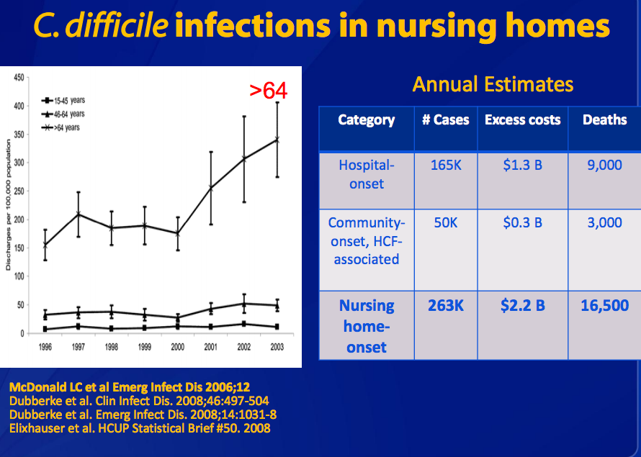

Slide 27
Background: Epidemiology
Risk Factors
Antimicrobial exposure
Acquisition of C. difficile
Advanced age
Underlying illness
Immunosuppression
Tube feeds
Gastric acid suppression FDA Drug Safety Communication: Clostridium difficile infection can be associated with stomach acid drugs known as proton pump inhibitors (PPIs) February 2012
Main modifiable risk
factors
Notes:
Although a number of risk factors for CDI have been described, the main modifiable risk factors are antimicrobial exposure and acquisition of C. difficile. Therefore, prevention efforts for CDI focus on reducing these risks.

Slide 28
My Mother-in-Law
Admitted to rehab facility s/p surgery
Foley placed for unclear reasons
Foley removed after multiple requests but UA and C&S sent for unclear reasons
Antibiotics initiated for positive urine culture
Antibiotics stopped after multiple requests
C difficile infection soon followed

Slide 29
When to Treat
Urinary Tract Infections
Long Term Care

Slide 30
Challenges
Comorbid illnesses may result in symptoms similar to UTIs.
Cognitive impairment may make reporting of symptoms difficult.
Older individuals can have atypical presentations for infections.
There is a lack of evidenced based guidelines for symptomatic UTIs.

Slide 31
Criteria for Surveillance, Diagnosis and Treatment
Based on consensus group recommendations
Modified by
  Recent clinical practice guidelines
  Current research

Slide 32
Criteria for Surveillance, Diagnosis and Treatment
Consensus group recommendations
McGeer criteria (recently revised) developed for surveillance and outcome assessments
  Used by Centers for Medicare and Medicaid Services
                Loeb criteria recommends minimal set of criteria necessary to initiate antibiotic therapy for UTI
  Similar to IDSA Guidelines

Slide 33
Revised McGeer
Resident Without Indwelling Catheter
(A) Clinical (At least one of the following must be met) | (B) Lab (At least one of the following must be met)
Either of the following: ☐ Acute dysuria or ☐ Acute pain, swelling or tenderness of testes, epididymis or prostate | 1. Voided specimen: Positive urine culture (> 10⁵ cfu/mL) no more than 2 organisms
If either FEVER or LEUKOCYTOSIS present need to include ONE or more of the following: □ Acute costovertebral angle pain or tenderness □ Suprapubic pain □ Gross hematuria □ New or marked increase in incontinence □ New or marked increase in urgency □ New or marked increase frequency | 2. Straight cath specimen: Positive urine culture (> 10² cfu/mL) any number of organisms
3. If neither FEVER or LEUKOCYTOSIS present INCLUDE TWO or more of the ABOVE. | Infect Control Hosp Epidemiol 2012;33:965-977

Slide 34
Revised McGeer
Resident With Indwelling Catheter
(A) CLINICAL (At least one of the following present with no alternate explanation) | (B)LAB (Must be met)
☐ Fever | ☐ Positive urine culture (> 10⁵ cfu/mL) of any organism(s)
☐ Rigors
☐ New onset hypotension
☐ Either acute change in mental status or acute functional decline, with no alternate diagnosis AND leukocytosis
☐ New onset costovertebral angle pain or tenderness
☐ New onset suprapubic pain
☐ Acute pain, swelling or tenderness of the testes, epididymis or prostate
☐ Purulent drainage from around the catheter | Infect Control Hosp Epidemiol 2012;33:965-977

Slide 35
Revised McGeer
Comments
Culture specimens should be processed as soon as possible, preferably within 1-2 h.
If urine specimen cannot be processed within 30 minutes of collection, it should be refrigerated.
Refrigerated specimen should be cultured within 24 h.
Infect Control Hosp Epidemiol 2012;33:965-977

Slide 36
Loeb Minimal Criteria 2001
Initiating Antibiotics
No Indwelling Catheter
Chronic Indwelling Catheter
Acute dysuria Or
Fever* + new or worsening (must have at least one of following)
  Urgency
  Frequency
  Suprapubic pain
  Gross hematuria
  Costovertebral angle tenderness
  Urinary incontinence
Must have at least one of the following
Fever*
  New costovertebral angle tenderness
  Rigors (shaking chills)
  New onset delirium
  *Fever > 100° or 2.4° F above baseline
        ICHE 2001;22:120-124

Slide 37
Criteria for Surveillance, Diagnosis and Treatment
Clinical Practice Guidelines
Infectious Disease Society of America (IDSA) Clinical Practice Guidelines Fever and Infection Long-Term Care Facilities 2008 CID 2009;48:149-171
IDSA Clinical Practice Guidelines Catheter-Associated Urinary Tract Infections Adults 2009 CID 2010;50:625-663
IDSA Guidelines Asymptomatic Bacteriuria CID 2005;40:643-654

Slide 38
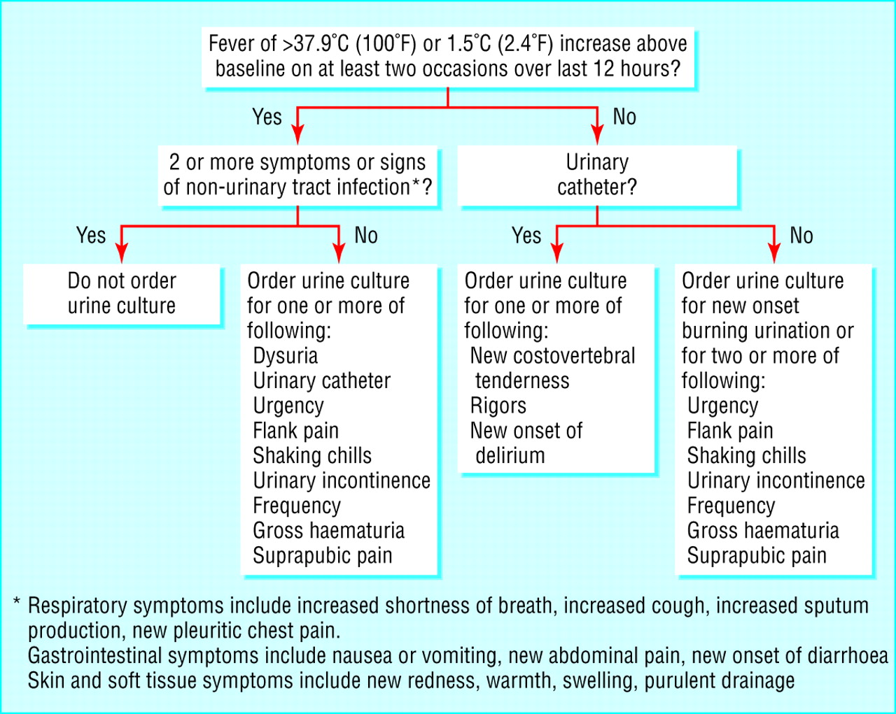

Criteria for Surveillance, Diagnosis and Treatment
Current Research
Diagnostic algorithm for ordering urine cultures for NH residents in intervention arm
Loeb M et al. BMJ 2005;331:669
©2005 by British Medical Journal Publishing Group
Notes:
Diagnostic algorithm for ordering urine cultures for nursing home residents in intervention arm

Slide 39
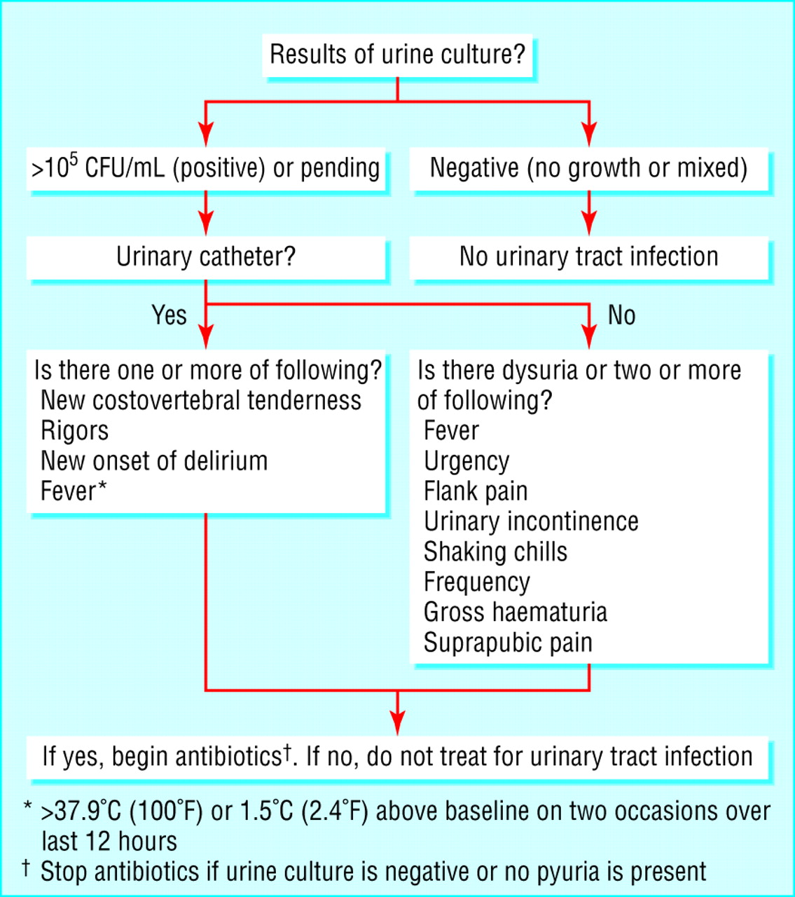
Treatment algorithm for prescribing antimicrobials to NH residents in intervention arm
Loeb M et al. BMJ 2005;331:669
©2005 by British Medical Journal Publishing Group
Notes:
Treatment algorithm for prescribing antimicrobials to nursing home residents in intervention arm

Slide 40
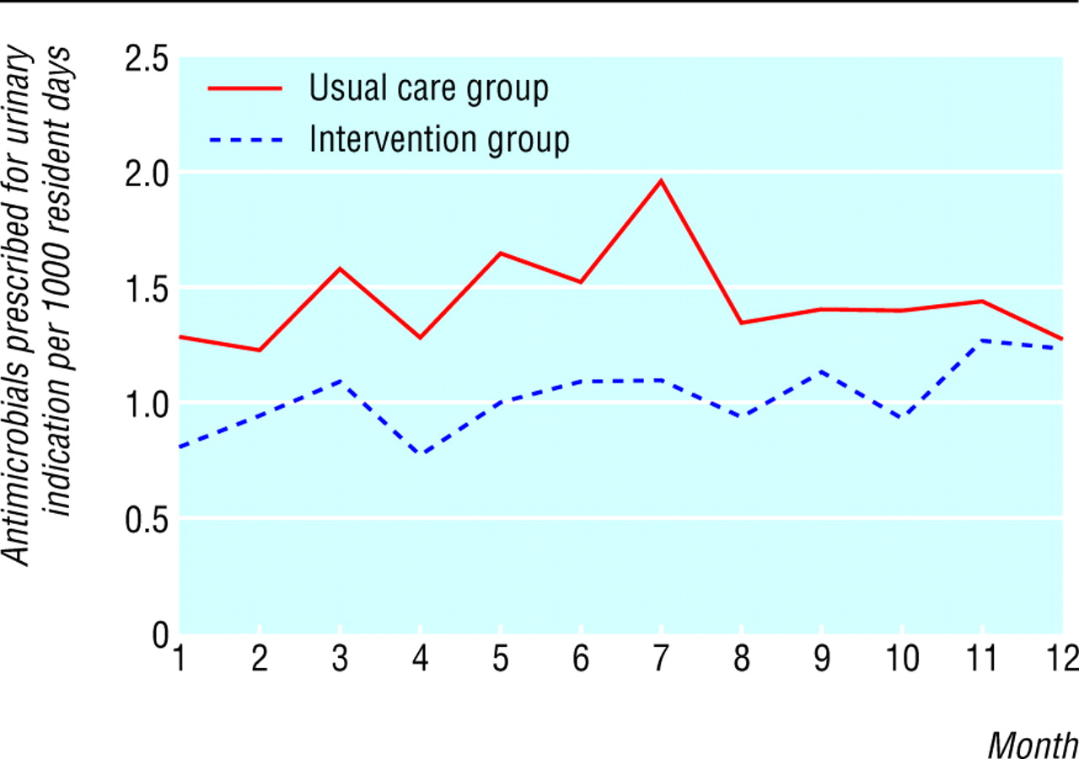
Monthly rates of antimicrobial prescriptions for urinary indications in intervention and usual care nursing homes.
Loeb M et al. BMJ 2005;331:669
©2005 by British Medical Journal Publishing Group
Notes:
Monthly rates of antimicrobial prescriptions for urinary indications in intervention and usual care nursing homes

Slide 41
Preventing Unnecessary Use of Antibiotics
ASSESSMENT protocols
  Bacterial infection less likely if resident afebrile, CBC normal, no signs/symptoms of focal infection
SPECIFIC CRITERIA for initiating antibiotics
  Loeb criteria UTI
OBSERVATION as a STANDARD MEDICAL PROCEDURE
  Monitoring protocols
                JAMDA 2010;11:537-539

Slide 42
When Antibiotics are Not Prescribed
(Monitoring Protocol)
Monitor vital signs for several days
Monitor for progression of symptoms or change in clinical status
Encourage fluid intake
Consider alternate diagnosis for nonspecific symptoms
If symptoms resolve, no further intervention required
                Annals of LTC April 2012;20:23-29

Slide 43
Change in Mental Status ≠ Symptomatic Urinary Tract Infection
LTCF residents with cognitive impairment are more likely to have ASB (no symptoms, positive urine culture).
LTCF residents with cognitive impairment are more vulnerable to changes in mental status with any new problem.
THEREFORE, resident with cognitive impairment and change in mental status
  MORE LIKELY to have a positive urine culture,
  Independent of whether infection is the cause of clinical decline,
  OR if infection is present, whether urinary tract is the source.
        JAGS 2009 57:1113-1114

Slide 44
Change in Mental Status in Dementia
Acute change in cognition
  Confusion
  Impaired function
Acute change in behavior
  Aggression or agitation (verbal or physical)
  Resistance to care
  Hallucinations
  Delusions
  Lethargy
Delirium: Fluctuations in mental status, inattention, disorganized thinking, altered level of consciousness

Slide 45
Change in Mental Status: Delirium(s)
D Drugs Dementia Discomfort | BEERS Criteria (e.g., anticholinergic, benzodiazepines, hypnotics) OR dose change Dementia Lewy bodies: Fluctuations in alertness and attention Pain
E Eyes, ears, environment | Sensory deprivation; vulnerability to environment
L Low oxygen states | Myocardial infarction, stroke, pulmonary embolus
I Infection | Pneumonia, sepsis, symptomatic UTI
R Retention | Urinary retention, constipation
I Ictal states | Seizure disorder
U Underhydration/nutrition | Dehydration
M Metabolic Causes | Low or high blood sugar, sodium abnormalities
S Subdural hematoma | Head trauma Adapted from Saint Louis University Geriatric Evaluation Mnemonics Screening Tools

Slide 46
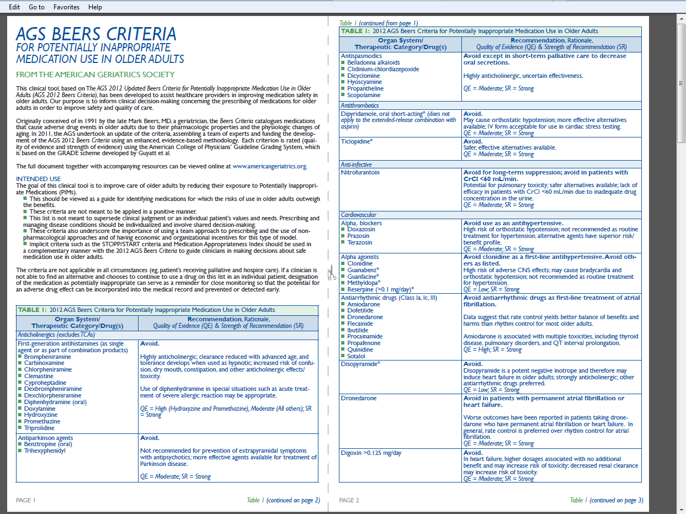
Beers Criteria 2012

Slide 47
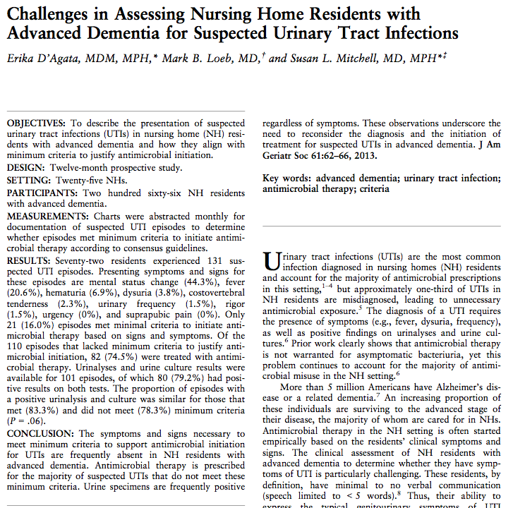

Slide 48
Case Weekend Sign-Out
LTC resident
  Low back pain (worse with movement)
  Family concerned new onset lethargy, history UTIs
PMH: Parkinson’s disease dementia
PE: VSS Normal exam- at baseline
Labs: WBC normal, UA pyuria, urine culture +
Impression?

Slide 49
Case Weekend Sign-Out
Given lack of signs or symptoms resident most likely has asymptomatic bacteriuria (seen in 25-50% females in LTCF). Hesitant to treat with no clinical indication given would be at risk for complications from antibiotics (adverse side effects, MDRO, C difficile infection) without any clear benefit. We will closely monitor the resident to see if anything evolves.

Slide 50

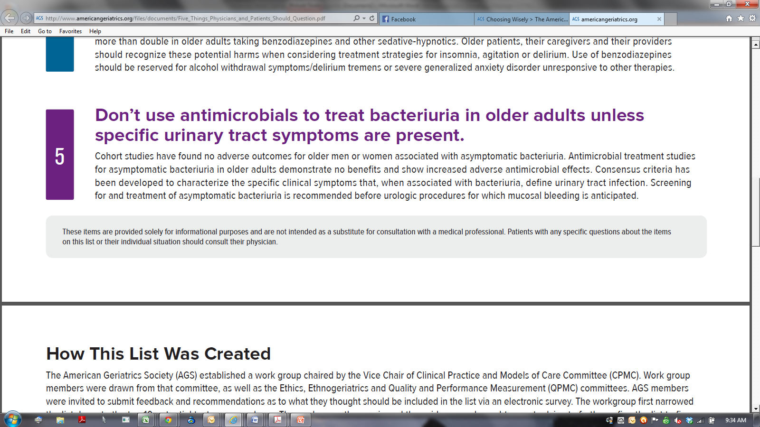

Slide 51
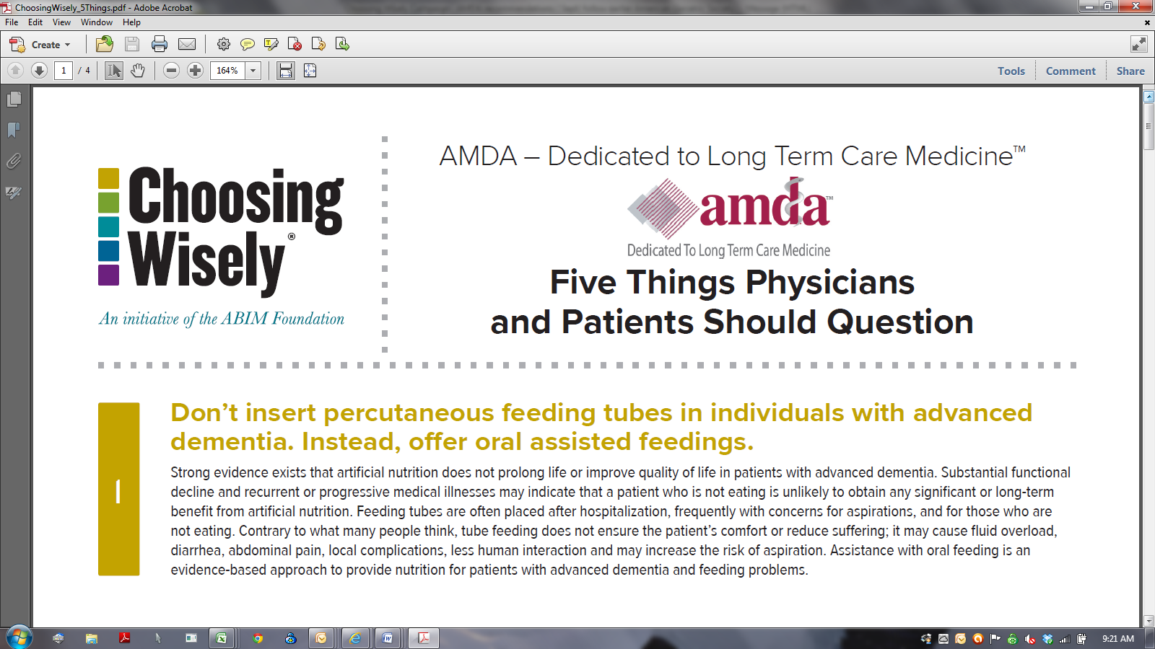
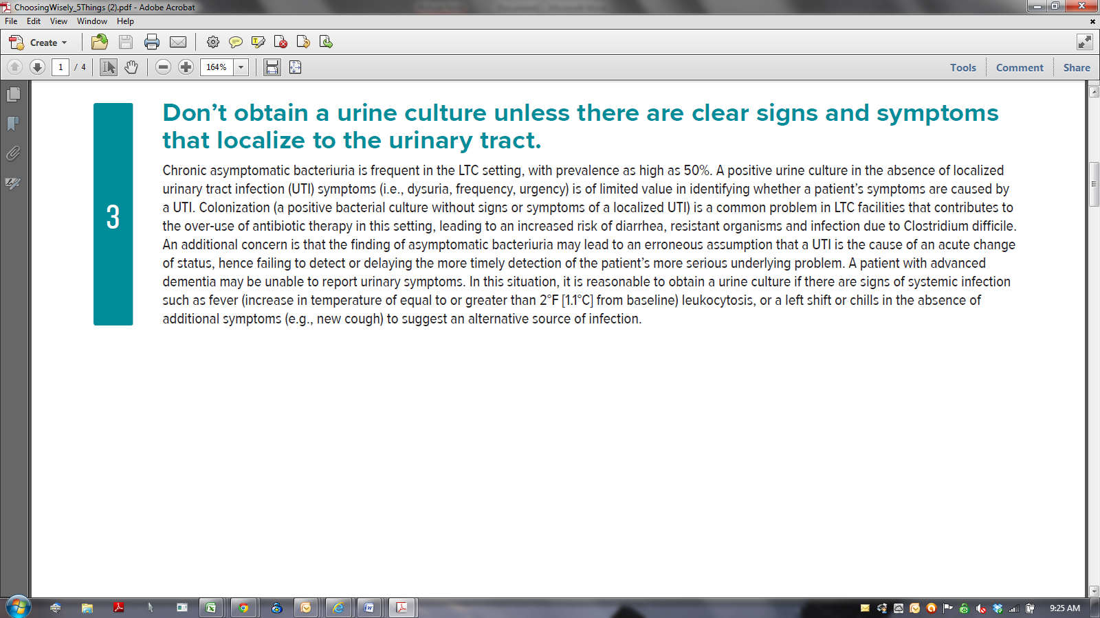

Slide 52
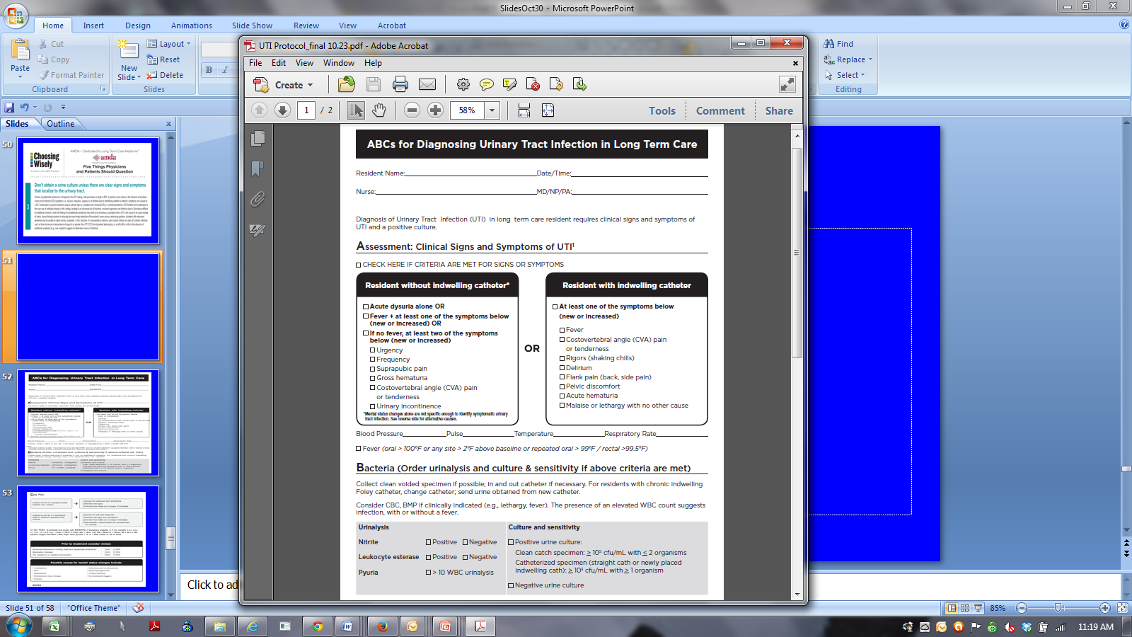

Slide 53
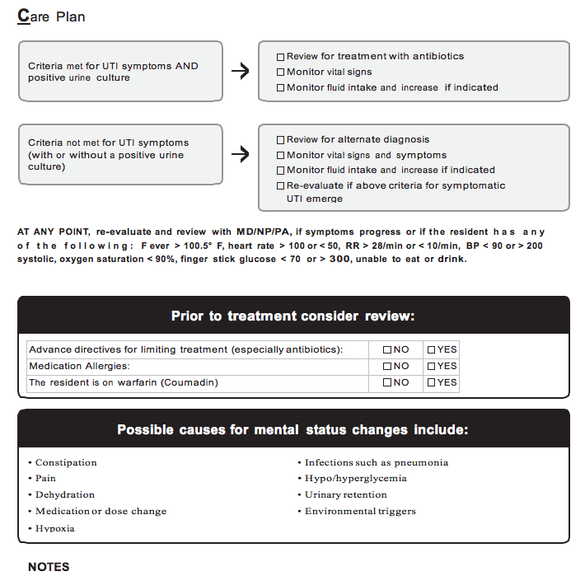

Slide 54
Collecting Urine Samples
Mid-stream or clean catch specimen for cooperative and functionally capable individuals. However, often necessary
  For males to use freshly applied, clean condom (external) catheter and monitor bag frequently
  For females to perform an in-and-out catheterization
Resident with indwelling catheter >14 days
  Change catheter prior to collection (sterile technique/equip.)
Resident with indwelling catheter < 14 days
  Obtain by sampling through the catheter port using aseptic technique
  If port not present may puncture the catheter tubing with a needle and syringe
  If catheter in place > 2 weeks at onset of infection, replace
  I CHE 2012;33:965-977
                CID 2009;48:149-171
                CID 2010;50:625-663

Slide 55
Role of Dipstick Testing in the Evaluation of Urinary Tract Infection in Nursing Home Residents
Negative dipsticks tests for leukocyte esterase and nitrites do not support UTI BUT cannot completely rule it out
  Leukocyte esterase (LE)
    Enzyme found in white blood cells
  Nitrites
    ONLY CERTAIN BACTERIA reduce
    urinary nitrates to nitrites
                Infect Control Hosp Epidemiol 2007;28:889-891
                Am Fam Phys 2005;71:1153-1162

Slide 56
Urine Culture
A urine culture should always be obtained when evaluating SYMPTOMATIC infections.
Urine cultures will assist in appropriate antibiotic selection.
A negative urine culture obtained prior to initiation of antibiotics excludes routine bacterial urinary tract infection.
Repeat urine culture following treatment (“test of cure”) is NOT recommended.

Slide 57
Blood Cultures
Obtain when suspect urosepsis (along with urine culture)
  High fever
  Shaking chills
  Hypotension

Slide 58

TOOLS TO SUPPORT CHANGE http://macoalition.org/evaluation-and-treatment-uti-in-elderly.shtml

Slide 59
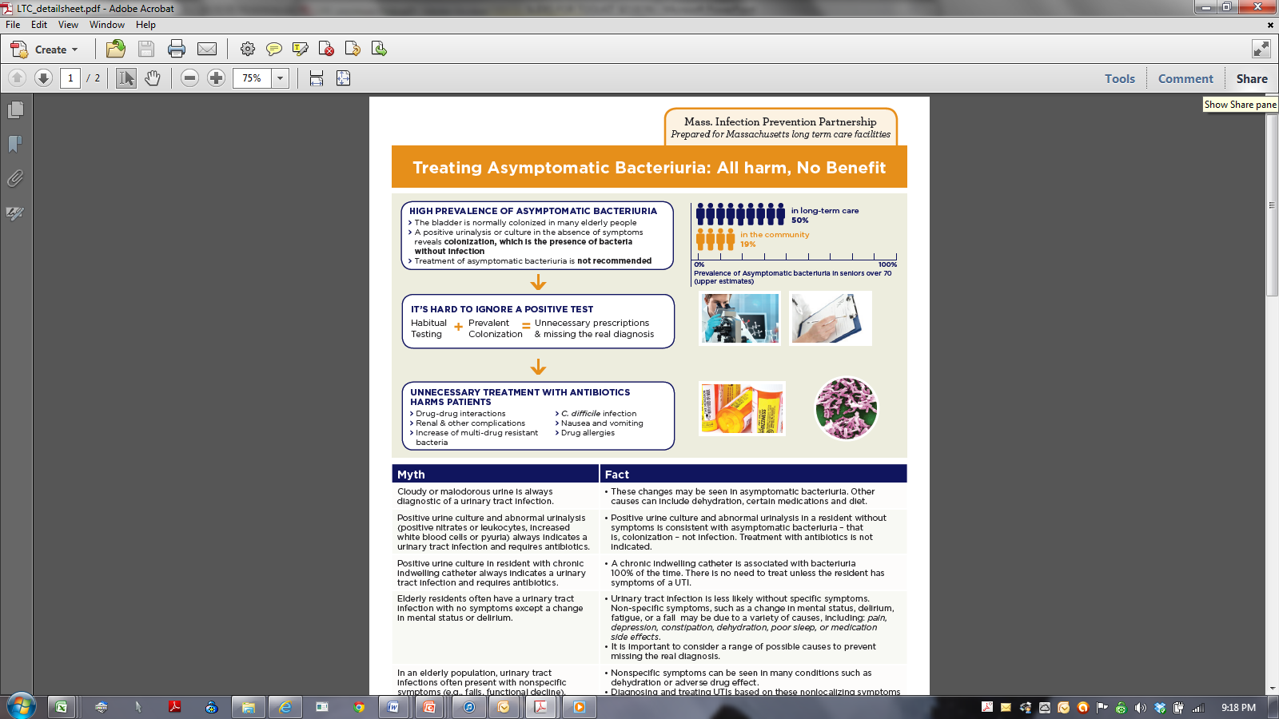
Clinician Education Sheet
Support tool for clinician education
Additional tool available for acute care emergency departments
Revision underway for LTAC and hospitals

Slide 60
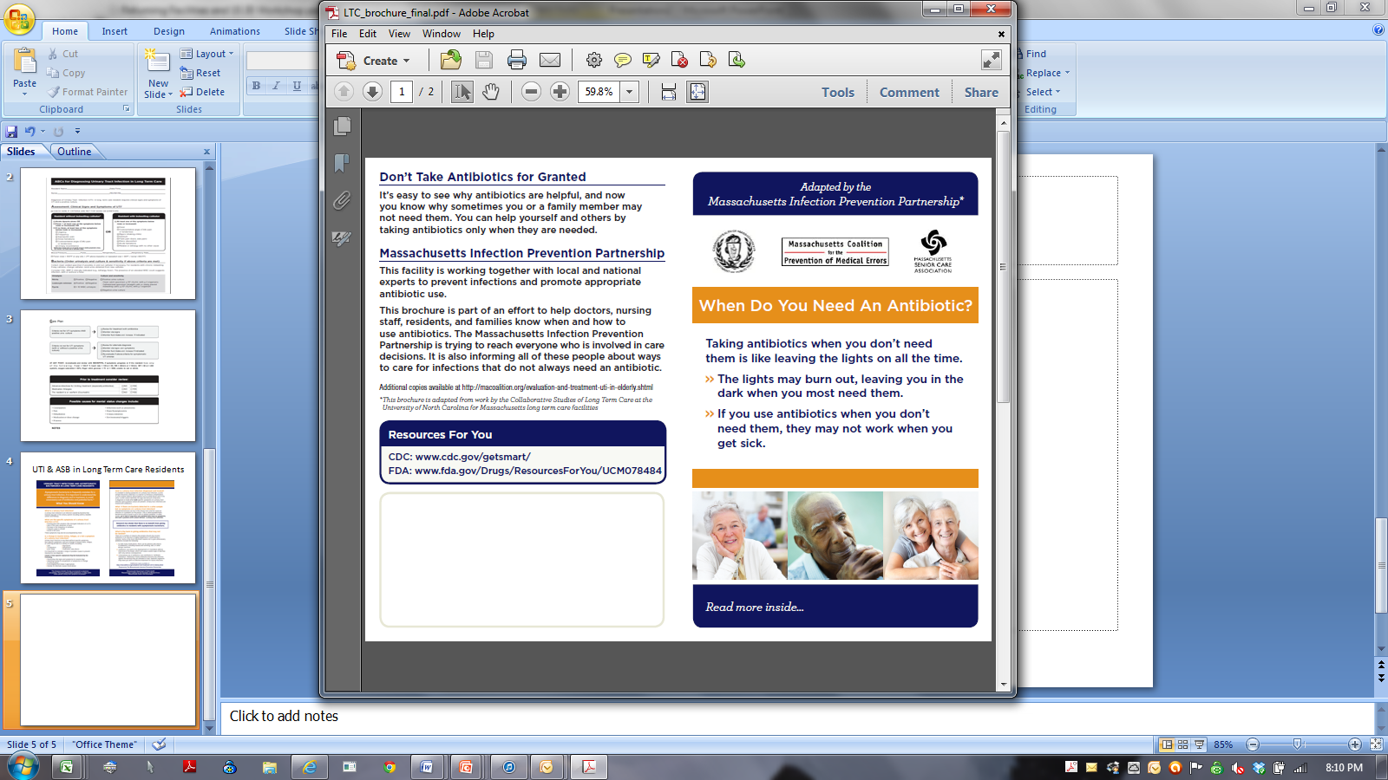
When do you need an antibiotic?
To educate residents and families about the importance of prudent use of antibiotics
Additional brochure available developed for emergency departments
If interest, will adapt for LTAC and hospitals.

Slide 61
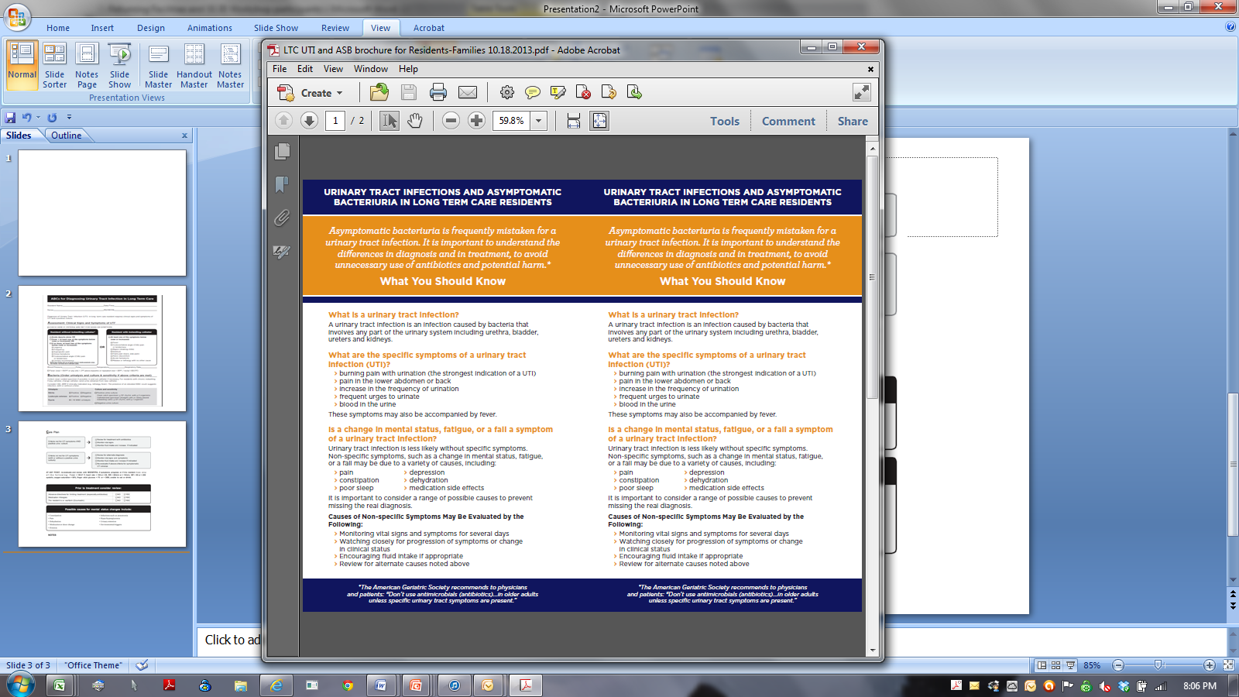
UTI & ASB in Long Term Care Residents
2 sided, print 2 per page
Addresses specific issues around UTI and ASB in the elderly
If interest, will adapt for LTAC and hospitals

Slide 62
Key Points
Routine screening for and treatment of ASB is not recommended
  In older individuals in the community
  In elderly residents in LTCFs
Join the national initiative to decrease CAUTI
Get Smart About Antibiotics
  Antibiotic resistance is one of the world’s most pressing public threats.
  Clostridium difficile infections are on the rise and are associated with increased mortality especially among the elderly
Treat only symptomatic urinary tract infections in the elderly
  Refer to clinical guidelines to assist in making a diagnosis
  Use tools found on the Massachusetts Coalition for the Prevention of Medical Errors website

